Slide 1
Linear Regression Lines (Part 2)
Instructor: Hamed Hasheminia
Lecture 5

Slide 2
Agenda
Non-Linear Terms (Python)
Hypothesis test – test of significance on regression coefficients
P-values
Different types of errors and R²
Interaction Effects
Notes:
Interpretation of models from last class:
y = b0 + b1x
change in y for unit change in x
y = b0 + b1log(x)
change in y for 1% change in x
log y = b0 + b1x
% change in y for unit change in x
log y = b0 + b1log(x)
% change in Y for % change in X (elasticity in econ)

Slide 3

Hypothesis Test on Single Variable Regression lines
Here is an example of a Single Variable Regression Model
What will happen to our coefficients if there is no relationship between X and Y? Can we still use X to predict Y?

Slide 4
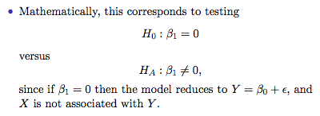
Hypothesis Test on Single Variable Regression lines

Slide 5

Hypothesis Test on Single Variable Regression lines
We use Statistical Software to compute the probability of estimating a coefficient as large as given that true population coefficient is .
The above-mentioned probability is called the p-value.
Ideally we want p-value be as small as possible.
In many applications p-value < 5% is an acceptable value. In almost all application p-value < .1% is considered really good.
Notes:
P-value is the probability that the null hypothesis is true, while you reject it based on the evidence you found. Alpha.

Slide 6

Hypothesis Test on Multi-Variable Regression lines
For multi-Variable Regression lines we have two types of hypothesis test
Hypothesis test for significancy of our model
Hypothesis test for significancy of each of our variables.
Always start with Hypothesis test for the whole model and then check individual variables.
Here is our multi-variable regression model:
What values of coefficient will make our model useless?
Notes:
Null hypothesis test: all Bs are equal to 0
Alt: at least one is not equal to 0
Pass this bar (called the F-statistic) and then go and test each individual B against the B=0 hypothesis.

Slide 7
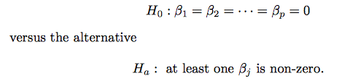
Hypothesis test of the model
Again we use statistical software to calculate the probability of estimating such large beta_js given that null hypothesis is True. This is called the p-value of your model. Again, we want it be as small as possible. Usually p-values less than 5% is acceptable.

Slide 8
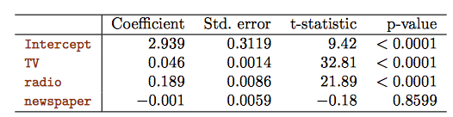
Hypothesis test of coefficients
The idea behind hypothesis test for coefficients is the same as single variable regression lines.
You prefer to solely work with significant variables / If you observe insignificant variables you usually need to get rid of them and run your multivariable regression lines without those variables.
If you have more than one insignificant variables, start dropping the most insignificant variable. If after removing that variable you still have insignificant variables, drop them one by one, until you are left with no insignificant variables. This method is called backward selection.

Slide 9
RSS, TSS, and R²
Our goal is to measure how much of the variability of the model is captured by our linear models.
What is the worst model possible?
The worst model is something that does not use anything from your X variable to predict Y
My worst predictor is average value of Y. This value is independent from X. Any model shall perform better than this one.
Total Sum Square – TSS - is the error associated with our worst model. This is the error we would like to beat.
Residual Sum Square – is the error remained to be captured.
R² is the ratio of the captured error and total error.
R² = (TSS-RSS)/TSS = 1 – RSS/TSS
Notes:
R^2 measures how much of the variability of your data is captured by your linear model.
TSS is the summation of obs minus average outcome^2 (Y - Y-bar^2)
RSS = residual sum squared (y – y-hat)^2
R^2 = TSS-RSS/TSS = 1 – RSS/TSS
Model with the better R^2 is usually better, when they both have the same number of vars

Slide 10

Interaction effects
In our previous analysis of the Advertising data, we assumed that the effect on sales of increasing one medium is independent of the amount spent on the other media
For example, the linear model
states tat the average effect on sales of a one-unit increase in TV is always beta_1, regardless of the amount spend on radio.
Notes:
Only use interaction effects measures if you have domain knowledge.

Slide 11
Interaction effects - continued
But suppose that spending money on radio advertising actually increases the effectiveness of TV advertising, so that the slope term for TV should increase as radio increases.
In this situation, given a fixed budget of $100,000, spending half on radio and half on TV may increase sales more than allocating the entire amount to either TV or to radio.
In marketing, this is known as a synergy effect, and in statistics it is referred to as an interaction effect.

Slide 12
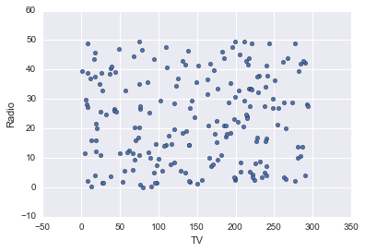
TV vs Radio Scatterplot

Slide 13
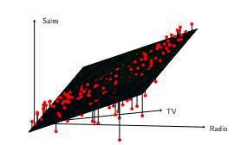
Interaction in the Advertising data?
When levels of either TV or radio are low, then the true sales are lower than what predicted by the linear model.
But when advertising is split between the two media, then the model tends to underestimate sales.

Slide 14
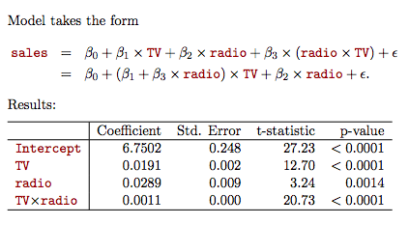
Modeling interactions – Advertising data
Notes:
To look at synergy effects, you just add one variable to your model which is the product of the two variables that are working synergistically
For every $1K on TV, given that we have already spent 30K on radio, we expect 50 more sales

Slide 15
Interpretation
The results in the table suggests that interactions are important.
The p-value for the interaction term TV X radio is extremely low, indicating that there is strong evidence for beta_3 be different from zero.
The R² for the interaction model is 96.8%, compare to the 89.7% for the model without interaction. That means 69% of the variability in sales that remains after fitting the additive model has been explained by the interaction term.

Slide 16


Interpretation - continued

Slide 17
Hierarchy
Sometimes it is the case that an interaction term has a very small p-value, but the associated main effects (in this case TV and radio) do not.
The hierarchy principle
If we include an interaction in a model, we should also include the main effects, even if the p-values associated with their coefficients are not significant.
Notes:
Hierarchy effect: if you want to keep your interaction effect, you must have your main effect there as well. You should never drop it.
So you can never drop TV and radio in the previous slide. Regardless of the pvalue.
And the same hierarchy rule goes for lower order of polynomials, when you have higher order polynomials in your model.

Slide 18
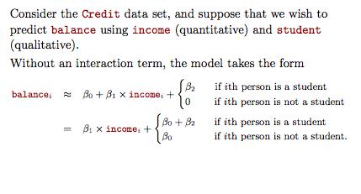
Interaction between qualitative and quantitative variables

Slide 19
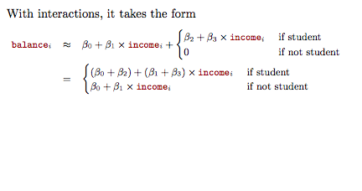
Interaction between qualitative and quantitative variables

Slide 20
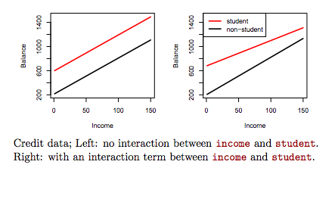
Notes:
The difference in student vs. non student is just the intercept with no interaction effects. However with the income and student interaction effects, you observe that balance starts to converge between students and non students with higher income.

Slide 21
Summary
Hypothesis test on regression coefficients
P-Value
R²
Interaction effect (two quantitative variables)
Interaction effect (A quantitative and categorical variable)

